Slide 1
NEW HIRE BENEFITS PRESENTATION
US Benefits Team

Slide 2
Agenda What we’ll cover today
1. Your Benefits Options
2. Employee Savings Plan – 401(k)
3. How to enroll in your Benefits
4. Who to Contact

Slide 3
Benefit options
You have 30 days from your date of hire to enroll into benefits. Changes to benefits selection can
only be made due to a Qualifying Life Event (QLE)
Medical & Pharmacy
Accident, Hospital Indemnity & Critical Illness
Dental
Vision
HSA
Limited FSA
Legal Services
Voluntary Life and AD&D
401K

Slide 4
Health insurance Aetna & Optum Rx
Travelport offers 2 medical plans
High HSA (High deductible health plan w/Health savings account)
Low HSA (High deductible health plan w/Health savings account)
You can enroll yourself, dependent children, and a spouse/partner as long as that spouse or partner is not eligible for
subsidized coverage elsewhere.
Both plans are qualified HDHPs and use the same network of providers.
Prescription drug coverage is administered through Optum Rx.

Slide 5
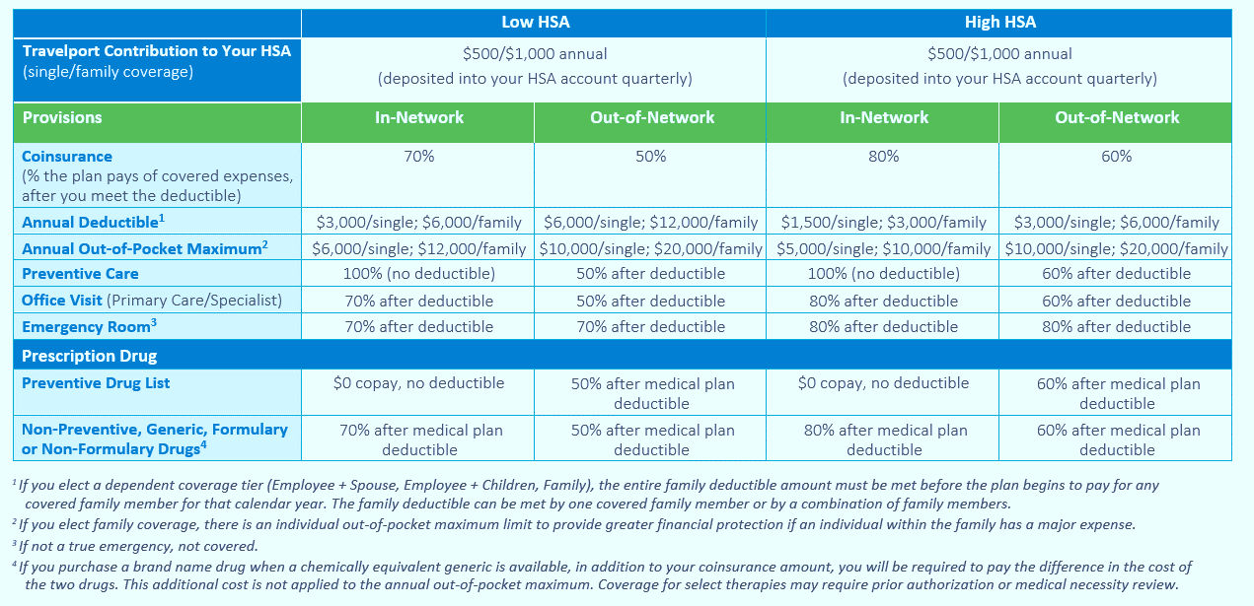
Comparing your medical options

Slide 6
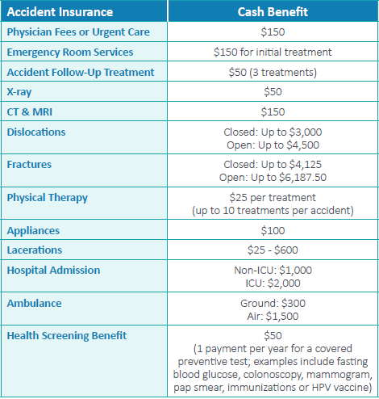
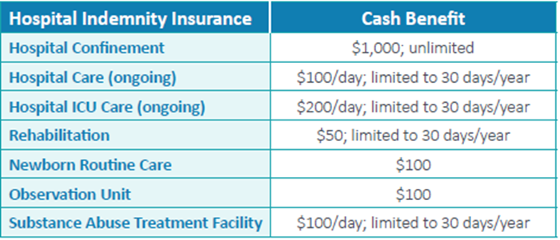
Additional protection: Supplemental medical planS

Slide 7
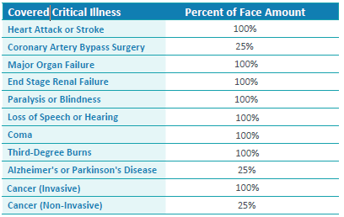
Additional protection: Supplemental medical plans – max benefits $15,000

Slide 8
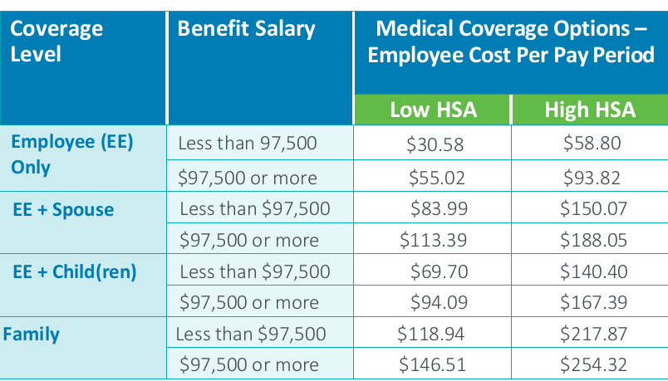
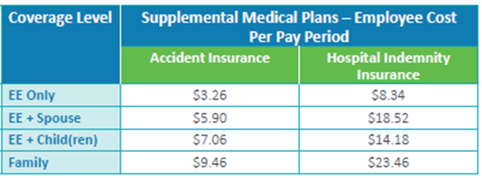
2021 medical/ supplemental medical contributions

Slide 9
terminology
A premium is the amount that you contribute via payroll.
A deductible is the annual amount you must pay before the plan pays any benefits. In-network preventive care is covered 100% and is not subject to the deductible. If you enroll in one of the HDHP/ HSA options, prescription drugs are subject to the medical plan deductible as well.
Coinsurance is your share of the cost of covered services after you reach the deductible. For example, the plan may pay 80% of an in-network expense and you are responsible for the other 20% (which is your coinsurance amount), up to an annual maximum. Once you and/or your family meet the annual out-of-pocket maximum, the plan pays 100% of the remaining covered expenses for the year.

Slide 10
2021 plan design (dental and vision) dental (Cigna) – vision (vsp)
 | In-Network | Out‑of‑Network
Annual Deductible Individual Family | $50 $100 | $75 $150
Diagnostic & Preventive Services | 100%, no deductible | 80%, after the deductible
Basic Restorative Services | 80%, after the deductible | 80%, after the deductible
Major Restorative Services | 50%, after the deductible | 50%, after the deductible
Annual Maximum Benefit | $2,000 per person | $1,500 per person
Orthodontia | 50% to a separate $2,000 lifetime maximum | 50% to a separate $1,500 lifetime maximum
If You Receive Your Care or Service Through
 | A VSP Member Provider | A Non-VSP Provider¹
Eye Exams | 100% after a $10 copay | After $10 copay, reimbursement up to $50
Lenses: Single Bifocal Trifocal | 100% after a $20 copay 100% after a $20 copay 100% after a $20 copay | After $20 copay, reimbursement up to $50 up to $75 up to $100
Frames | $150 allowance after a $20 copay;² lenses and frames purchased together are subject to one $20 copay | After $20 copay, reimbursement up to $70
Elective Contacts³ (once per year instead of regular lenses) | For contact lenses: $150 allowance For fitting and evaluation: 100% after a not to exceed $60 copay | $105 allowance for contact lenses and exam

Slide 11
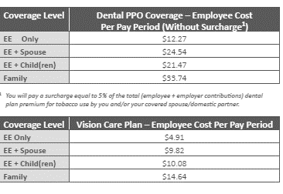
2021 Dental vision rates

Slide 12
Health savings account (hsa) fidelity
A personal account with triple tax advantages
Contribution through payroll is pre-tax
Money used for qualified expenses is tax free
Money grows tax-free when invested
HSA can be used to cover cost of your higher deductible, other qualified healthcare expenses or save for later
Balances roll over from year to year; account remains yours even if you switch plans or leave Travelport
Travelport makes an annual contribution of $500.00 for Employee Only coverage and $1,000.00 for Family, Employee + Spouse or Employee + Child(ren) coverages
Employer contributions are made via quarterly increments of $125.00 per quarter for Employee Only coverage and $250.00 for Family, Employee + Spouse or Employee + Child(ren) coverages.
Employee must be eligible for benefits at the beginning of each quarter to receive Travelport Quarterly HSA Contribution
Employee must have an “open and active” Fidelity HSA account.
Quarterly contributions are deposited in your active Fidelity Health Savings Account.

Slide 13
Limited flexible spending account Payflex
2021 Limited FSA
Qualifying Dental and Vision expenses only.
Can not be used for medical and prescription drug expense
“Use It or Lose It” rule
Annual Maximum $2,750 on a pre-tax basis
Dependent Care FSA
Child and/or elder care expenses
Annual maximum $5,000 per family

Slide 14
Life , AD&D, STD, LTD Insurance Lincoln financial
Basic Life & AD&D Insurance:
1.5x annual salary
Employer Paid Benefit
Voluntary Life:
1 to 8x annual salary up to $1,500,000
Employee pays full cost of benefits
Short term disability:
Provides benefits up to 26 weeks;
Schedule of STD based on length of time with Travelport
Long-term disability:
Pays 60% of basic monthly earnings
Other Benefits:
Teladoc
Talk to a doctor using your computer or mobile device
EAP
HealthAdvocate
Patient Advocacy Services
Legal Services (Hyatt Legal Plans)
ID Theft (Id Watchdog)

Slide 15

Employee savings plan, 401(k)
401(k) Plan
Fidelity

Slide 16
Travelport employee savings plan fidelity
The Travelport Employee Savings Plan [401(k) Plan] is designed to help you build retirement income for your future
You may contribute up to 75% of your eligible earnings, up to the annual IRS maximum, on pre-tax basis, Roth after-tax basis or a combination of both. If you are age 50 or older, you may also contribute additional “catch-up” contributions, subject to IRS limits.
When you save on a pre-tax basis, federal and state income taxes are deferred, so you benefit from tax savings now, as well as, building for your financial future.
With Roth after-tax contributions, you pay taxes before they are deposited to your 401(k) Plan account. You are not taxed when you withdraw the contributions or if the earnings are a“ Qualified Distribution” in the future.
Your contributions are automatically deducted regularly from your paycheck
Although your 401(k) Plan account is intended for your retirement future, you may borrow from your account or withdraw funds under certain circumstances.

Slide 17
Travelport employee savings plan
Regular full-time employees are eligible to enroll in the 401(k) Plan immediately provided they are at least age 18 on their date of hire.
Part-time employees may participate on January 1 or July 1 following the later of attaining age 18 and completion of one year of service (1,000 hours).
You are automatically enrolled in the 401(k) Plan at 3% of eligible pay beginning 30 days after your date of hire, subject to eligibility provisions, unless you elect a different contribution percentage or opt-out during the 30-day period.
If you are automatically enrolled, your contributions will increase 1% automatically each year beginning on your second anniversary up to a maximum of 10% of eligible pay unless you opt-out of the annual increase program.
You are always 100% vested in your own contributions.
100% Employer Match toward the 1st 3% Employee Contribution
50% Employer Match toward the next 2% Employee Contribution.
***With up to a 4% TP match maximum ***

Slide 18
Travelport employee savings plan Investment Options
To help meet your investment goals, the 401(k) Plan offers a wide variety of investment options ranging from
conservative to more aggressive depending on your risk tolerance.
The 401(k) Plan also offers FIAM Blend Target Date Commingled Pool, also known as lifestyle funds, that offer a blend of stocks, bonds and short-term investments within a single fund. The funds’ asset allocation is based on the year closest to your retirement date (age 65).
When you enroll in the 401(k) Plan, you decide how your contributions are invested.
If you do not select an investment fund(s), your contributions will be invested in the FIAM Blend Target Date
Commingled Pool fund most appropriate for your age. The FIAM Blend Target Date Comingled Pool is the default
fund in the 401(k) Plan.
If you are unsure about making investment choices, the 401(k) Plan offers independent, objective investment advice
and account management through Fidelity Personal Planning and Advice. Advisory services may include a fee.

Slide 19
Travelport employee savings plan Enrollment
Enrolling in the 401(k) plan is quick and easy.
To enroll log into your 401(k) Plan account at www.netbenefits.com or contact the Travelport Retirement Benefits Center at 1-866-522-4015. Fidelity Investments serves as the 401(k) plan’s record keeper.
Simply elect how much you want to contribute from your paycheck on a pre-tax and/or Roth after-tax basis and select how you want your contributions invested.
Designate your beneficiaries.
Remember if you do nothing you will be automatically enrolled 30 days following your date of hire at a 3% pre-tax contribution rate.

Slide 20
Important contact information & how to enroll
Medical, Dental, Vision, etc.
Travelport Benefits Service Center – 1 (844) 611 8272
www.mytravelportbenefits.bswift.com (SSO) from Homeport
You may send a question via the bswift site: Navigate to Contact Us on the top right and choose to submit your inquiry via Secure Correspondence.
Submit your question via the US Benefits tile (SSO) from Homeport
Employee Savings Plan
www.netbenefits.com
Travelport Retirement Benefits Center at 1 (866) 522 4015
Retirementplans-us@Travelport.com

